Slide 1
VIEWS

Slide 2
INTRODUCTION
A database view is a virtual table or logical table which is defined as a SQL SELECT query with joins.
Can use queries
Can update data in database.
MySQL:
MySQL creates a temporary table based on the view definition statement and executes the incoming query on this temporary table.
MySQL combines the incoming query with the query defined the view into one query and executes the combined query.

Slide 3
MySQL supports versioning system for views.
Each time when a view is altered or replaced, a copy of the view is back up in arc (archive) directory that resides in a specific database folder. The name of the backup file is view_name.frm-00001 .
MySQL allows you to create a view based on other views.

Slide 4
Restrictions
If you drop or rename tables to which a view references, MySQL does not issue any error. But can use CHECK TABLE statement to check whether the view is valid or not.
A simple view can be updatable. A view created based on a complex SELECT statement with join, subquery, etc., cannot be updatable.
Not all views support INSERT, UPDATE, or DELETE operations. In general, in order to support these operations, the primary key and required fields must be present in the view. Complex multi-table views are generally read only.

Slide 5
CREATING VIEWS
CREATE
[ALGORITHM = {MERGE | TEMPTABLE | UNDEFINED}]
VIEW [database_name].[view_name]
AS
[SELECT statement]

Slide 6
VIEW PROCESSING ALGORITHMS
MERGE
MySQL first combines the input query with the SELECT statement, which defines the view, into a single query. And then MySQL executes the combined query to return the result set.
Cannot use aggregate functions.
combination of input query and the query in the view definition into one query is referred to as view resolution.

Slide 7
TEMPLATE
MySQL first creates a temporary table based on the SELECT statement that defines the view, and then it executes the input query against this temporary table.
Less Efficient.
Not Updatable.
UNDEFINED
create a view without specifying an explicit algorithm.

Slide 8
SELECT STATEMENT
Query data from any table or view that exists in the database.
can contain a subquery in WHERE clause but not in the FROM clause.
cannot refer to any variables including local variables, user variables, and session variables.

Slide 9
CREATING UPDATABLE VIEWS
Can use the INSERT,UPDATE,DELETE statement to insert, update or delete rows of the base table.
SELECT statement does not contain:
Aggregate functions such as MIN, MAX, SUM, AVG, COUNT, etc.
DISTINCT
GROUP BY clause.
HAVING clause.
UNION or UNION ALL clause.
Left join or outer join.
Subquery in the SELECT clause or in the WHERE clause that refers to the table appeared in the FROM clause.
Reference to non-updatable view in the FROM clause.
Can check if a view in a database is updatable by querying the is_updatable column from the views table in the information_schema database.

Slide 10
Ensuring Views Consistency
It is possible to update data which is not visible through the view making it inconsistent.
Use the WITH CHECK OPTION clause when you create or modify the view.
Syntax:
2 3 4 | CREATE OR REPLACE VIEW view_name AS select_statement WITH CHECK OPTION;

Slide 11
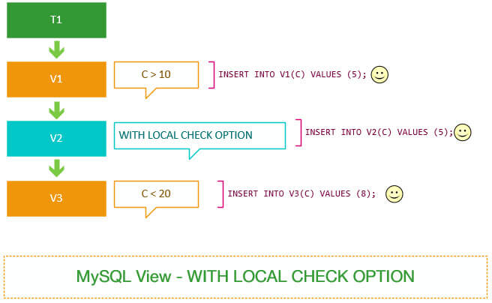
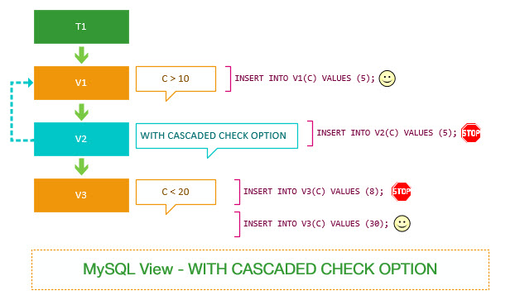
Types of check options
LOCAL
Restricts the CHECK OPTION only to the view being defined.
CASCADE
Checks underlying views

Slide 12
MANAGING VIEWS
Modify view using
ALTER VIEW
CREATE OR REPLACE VIEW
Removing views
DROP VIEWS
Display view definition
SHOW CREATE VIEW

Slide 13
SHOW CREATE VIEW [database_name].[view_ name];
ALTER
[ALGORITHM = {MERGE | TEMPTABLE | UNDEFINED}]
VIEW [database_name]. [view_name]
AS
SELECT statement]
CREATE OR REPLACE VIEW contacts AS
SELECT
firstName, lastName, extension, email
FROM
employees;
DROP VIEW [IF EXISTS] [database_name].[view_name]

Slide 14
ERROR GENERATION IN MySQL

Slide 15
SELECT * FROM no_such_table;
ERROR 1146 (42S02): Table 'test.no_such_table' doesn't exist
The message displayed contains three types of information:
A numeric error code (1146). This number is MySQL-specific and is not portable to other database systems.
A five-character SQLSTATE value ('42S02'). The values are taken from ANSI SQL and ODBC and are more standardized. Not all MySQL error numbers have corresponding SQLSTATE values. In these cases, 'HY000' (general error) is used.
A message string that provides a textual description of the error.

Slide 16
SIGNAL
Used to return an error or warning condition to the caller from a stored program e.g., stored procedure, stored function, trigger or event.
SIGNAL SQLSTATE | condition_value
[SET condition_information_item_name= value_1,
[, condition_information_item_name] = value_2, etc;]

Slide 17
SQL STATE:
5 character predefined alpha numeric code
Ex: 45000 : Unhandled user-defined exception
Condition_value
Ex: DECLARE specialty CONDITION FOR SQLSTATE '45000';
SET CLAUSE:
To provide user with information
The condition_information_item_name may be any of the following:
CLASS_ORIGIN
SUBCLASS_ORIGIN
MESSAGE_TEXT
MYSQL_ERRNO
CONSTRAINT_CATALOG
CONSTRAINT_SCHEMA
CONSTRAINT_NAME
CATALOG_NAME
SCHEMA_NAME
TABLE_NAME
COLUMN_NAME
CURSOR_NAME

Slide 18
RESIGNAL
Raise warning or error condition.
Must use the RESIGNAL statement within an error or warning handler.
RESIGNAL [SQLSTATE | condition_value]
[SET signal_information_item = value_1,
[, signal_information_item] = value_2, etc;]

Slide 19
THANKYOU

